Slide 1

NTE 1010
Introduction to Finance for Engineers
Spring 2020
week 5
Wednesday, March 18, 2020
Financial System & Money
Financial System

Slide 2
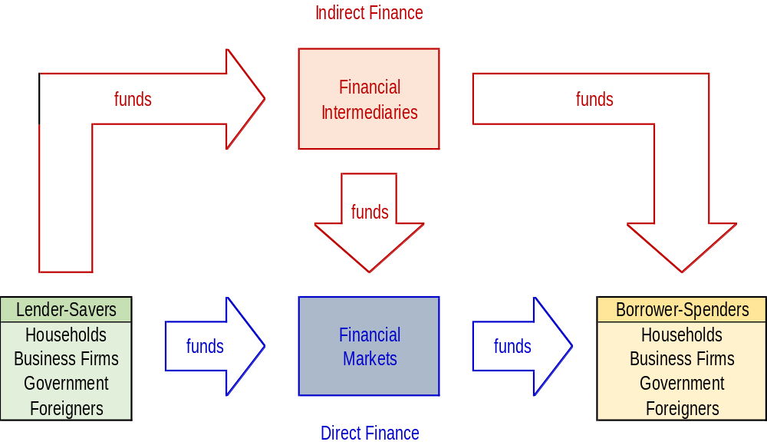
NTE 1010 – Introduction to Finance for Engineers
Flow of Funds through the Financial System
In Indirect Finance, borrowers borrow funds directly from Lenders in Financial Markets
by selling them securities (financial instruments)
which are claims on the borrower’s future income or assets.
Financial markets perform the essential economic function of channeling funds
from households, firms, and governments
that have saved surplus funds by spending less than their income
to those that have a shortage of funds because they wish to spend more than their income.

Slide 3
NTE 1010 – Introduction to Finance for Engineers
Financial Markets (Direct Finance)
Primary and Secondary Markets
Primary Market
is a financial market in which new issues of a Financial Security, such as a bond or stock,
are sold to initial buyers by the corporation or the government agency borrowing the funds.
Secondary Market
is a financial market in which securities that have been previously issued can be resold.
An important financial institution that assists in the initial sale of securities in the primary market
is the investment bank.
It does this by underwriting securities:
It guarantees a price for a corporation’s securities and then sells them to the public.
Securities brokers and dealers are crucial to a well-functioning secondary market.
Brokers are agents of investors who match buyers with sellers of securities;
dealers link buyers and sellers by buying and selling securities at stated prices.
Secondary markets serve two important functions:
First, they make it easier and quicker to sell financial instruments;
that is, they make the financial instruments more liquid.
Second, they determine the price of the security that the issuing firm sells in the primary market.

Slide 4
NTE 1010 – Introduction to Finance for Engineers
Financial Markets (Direct Finance)
Types of Secondary Markets
  Secondary markets can be organized in two ways:
  One method is to organize Exchanges, where buyers and sellers of securities
  (or their agents or brokers) meet in one central location to conduct trades.
  The New York Stock Exchange for stocks
  and the Chicago Board of Trade for commodities (wheat, corn, silver, and other raw materials)
  are examples of organized exchanges.
  As well as Borsa Istanbul and
  Izmir Ticaret Borsası (commodity trade).
  The other is to have an Over-the-Counter (OTC) market,
  in which dealers at different locations who have an inventory of securities stand ready
  to buy and sell securities ″over the counter″
  to anyone who comes to them and is willing to accept their prices.

Slide 5
NTE 1010 – Introduction to Finance for Engineers
Financial Markets (Direct Finance)
Money Markets and Capital Markets
Another way of distinguishing between markets is
on the basis of the maturity of the securities traded in each market.
A. Money Market
is a financial market in which only short-term debt instruments
(generally those with original maturity of less than one year) are traded;
B. Capital Market
is the market in which longer-term debt
(generally those with original maturity of one year or greater)
and equity instruments are traded.

Slide 6
NTE 1010.1 – Introduction to Finance for Engineers
Financial Markets (Direct Finance)
Further Categories
    Money Markets
    Capital Markets
    Futures and Derivatives Markets
      Futures are agreements to purchase an asset at a date in the future at a price that is agreed now.
      A swap is an agreement to exchange the rights to one asset for the rights to another.
        For example, a fixed interest rate loan may be swaped with a variable rate loan.
      An options contract provides the owner of the contract
      with the right to buy or sell within a period at a known price.
        (Spot markets are those in which payment and delivery occur within a few days.
        Unless otherwise indicated, financial markets are spot markets.)
    Foreign Exchange (FX) Markets
    Commodities Markets
      (for petroleum, for valuable metals such as gold and silver, for industrial metals such as copper and aluminum, for basic food such as wheat and corn)
      Most of the time physical settlements do not take place.
      Investors hedge (reduce risk exposure) or speculate (willingly take risk).

Slide 7
NTE 1010 – Introduction to Finance for Engineers
Financial Markets (Direct Finance)
Equity - Debt
Equity Markets
Debt Markets
A firm or an individual can obtain funds in a financial market
by issuing a debt instrument, such as a bond or a mortgage,
which is a contractual agreement by the borrower to pay the holder of the instrument
fixed dollar amounts at regular intervals (interest and principal payments)
until a specified date (the maturity date),
when a final payment is made.
The maturity of a debt instrument is the number of years (term)
until the instrument’s expiration date.
A debt instrument is short-term if its maturity is less than a year
and long-term if its maturity is ten years or longer.
Debt instruments with a maturity between one and ten years are said to be intermediate-term.

Slide 8
NTE 1010.1 – Introduction to Finance for Engineers
Financial Securities
Debt Instruments
  Secured debt is secured over one or more of the assets of the company,
  which means that in the case of liquidation,
  the proceeds from the sale of secured assets
  would be used to first meet the claims of the debt-holders.
  The secured assets are called collateral.
  In case of liquidation,
  there is a ranking of the claims on the assets of the company;
  senior debt has first claim
  and subordinated debt has a subsequent claim.
  Unsecured debt does not lay claim to any of the assets.

Slide 9
NTE 1010.1 – Introduction to Finance for Engineers
Financial Securities
Debt Instruments
  Fixed interest debt is that in which the interest rate is fixed for the period of the loan.
  Bonds are often fixed interest instruments.
  Variable interest or floating interest debt is that in which
  the interest rate is not fixed but varies according to the market rate.
  Mortgages are a common form of floating interest debt.

Slide 10
NTE 1010.1 – Introduction to Finance for Engineers
Financial Securities
Types of Loans
  Regular loan is one in which the interest is paid at regular periods during the term of the loan and the principal is paid at the end.
  Discount loan is structured so that the entire interest amount is paid in advance.
        The borrower receives the loan amount less the interest payment.
        At the end of the loan period, the borrower repays the principal amount.
  Instalment loan is one which is paid back in equal instalments.
    An instalment is composed of interest for the current period and partial principal repayment.
  A line of credit or revolving credit is a flexible form of short-term financing
  that allows the borrower to access funds up to a specified limit as needed.
    The company pays interest on the amount borrowed;
    however, it may be required to pay a (small) charge on the unused balance as well.

Slide 11
NTE 1010.1 – Introduction to Finance for Engineers
Financial Securities
Additional Debt Instruments
  A bond is a long-term loan agreement which sets terms for the principal, the coupon rate, the coupon frequency and the maturity.
    In case the coupon rate is variable, it is indexed to a specific rate such as prime rate, LIBOR, or inflation. The coupon payments are usually made semi-annually or annually.
  Leasing provides funding by allowing the company to use the leased assets without incurring the initial cost of purchase.
    Operational lease: e.g. cars where leasing company covers the operational expenses except for gasoline, highway tolls, etc. Asset is returned to the leasing company once the leasing period is over.
    Capital lease is used for investment equipment. The operating company covers the costs and generally buys the asset for a predetermined price once the leasing period is over.
  Factoring: Discounting of business’ receivables by a factoring company.
    Discount rate is higher if the factoring company accepts the non-payment risk.

Slide 12
NTE 1010 – Introduction to Finance for Engineers
Financial Markets (Direct Finance)
Equity - Debt
Debt Markets
Equity Markets
A firm or an individual can obtain funds in a financial market
by issuing equities, such as common stock,
which are claims to share in the net income (income after expenses and taxes)
and the assets of a business.
Equities often make periodic payments (dividends) to their holders
and considered long-term because they have no maturity date.
In addition, owning stock means that you own a portion of the firm
and thus have the right to vote on issues important to the firm and to elect its directors.
The main disadvantage of owning equity is that an equity holder is a residual claimant; that is,
the corporation must pay all its debt holders before it pays its euity holders in case of liquidation.
Its advantage is that equity holders benefit directly from
any increases in the corporation’s profitability or asset value
because equities confer ownership rights on the equity holders.

Slide 13
NTE 1010.1 – Introduction to Finance for Engineers
Financial Securities
Equity Types – Ordinary Shares
  There are two forms of equity in a business;
            Ordinary shares (common stock),
            Preferred stock.
  1. Ordinary Shares:
  The investors provide the share capital for partial ownership of the business.
  The return to the holders of ordinary shares
  is directly related to the performance of the business in two forms;
            The growth in the value of the company,
            The dividends paid by the company.
The holders of ordinary shares are exposed to the entire risk of the business.

Slide 14
NTE 1010.1 – Introduction to Finance for Engineers
Financial Securities
Equity Types – Ordinary Shares
The sale of new shares in an existing company can be in the form of
a rights offer or a follow-on offer.
If the company sells new shares to existing shareholders
who have pre-emptive right to subscribe to new shares,
it is called a rights offer.
This allows the shareholders to maintain their proportional share of the ownership of the company.
Current shareholders may also waive their right to subscribe to new shares.
In such a case, the company can raise equity capital
by selling new shares to new shareholders for cash; this called follow-on offer.
Companies can retain more of the profits by paying a smaller dividend;
this increases the equity capital of the company without selling additional shares.
The company may offer additional shares instead of a cash dividend;
this is known as stock dividend.

Slide 15
NTE 1010.1 – Introduction to Finance for Engineers
Financial Securities
Equity Types – Preferred Stock
              Ordinary shares (common stock)
              Preferred stock
Preferred Stock has the characteristics of both equity and debt.
Dividend offered by Preferred Stock is fixed, a percent of the face value of the shares.
These payments are similar to the interest payments on debt.
However, if there are insufficient funds, no payments are made
and this does not throw the company into bancruptcy.
Usually, these unpaid dividends accumulate and holders of Preferred Stock are paid in arrears.
Preference shares usually have no maturity date.
Unlike debt, the dividend payment to Preferred Stock is not tax-deductible.
In case of liquidation of the company,
the holders of Preferred Stock have a claim to to the assets
prior to that of the ordinary shareholders.

Slide 16
NTE 1010.1 – Introduction to Finance for Engineers
Financial Markets (Direct Finance)
Borsa İstanbul
    Established as İstanbul Menkul Kıymetler Borsası (İMKB)
    at the end of 1985.
    Converted to Borsa İstanbul A.Ş. at the end of 2012.

Slide 17
NTE 1010 – Introduction to Finance for Engineers
Stock Markets in the World
1- New York Stock Exchange, United States: Founded in 1792, the New York Stock Exchange has been the world’s largest stock exchange since the end of World War I, when it overtook the London Stock Exchange. It has a market capitalization of $22.9 trillion and about 2,400 listed companies.
2- NASDAQ, United States: The NASDAQ Stock Market was founded in 1971 in New York City. NASDAQ had a market capitalization of $10.8 trillion with an average monthly trading volume of $1.26 trillion.
3- Tokyo Stock Exchange, Japan: Founded in 1878, the Tokyo Stock Exchange has close to 2,300 listed companies with a combined market capitalization of $5.67 trillion.
4- Shanghai Stock Exchange, China: It has a market capitalization of $4.02 trillion. It has more than 1,000 listed companies. Though its origins date back to 1866, it was suspended following the Chinese Revolution in 1949. The Shanghai Exchange in its modern avatar was founded in 1990.
5- Hong Kong Stock Exchange, Hong Kong: The Hong Kong Stock Exchange was founded in 1891. It has close to 2,000 listed companies, about half of which are from mainland China. It has a market capitalization of $3.93 trillion.
6- Euronext, Eurozone: Headquartered in Amsterdam, the Netherlands, Euronext is a pan-European stock exchange with a presence in France, Belgium, Ireland, and Portugal. It has approximately 1,300 listed companies with a combined market capitalization of $3.92 trillion.
7- London Stock Exchange, United Kingdom: The London Stock Exchange was founded in 1698. It has more than 3,000 listed companies with a combined market capitalization of $3.76 trillion.
8- Shenzhen Stock Exchange, China: Formally established in 1990, the Shenzhen Stock Exchange has a market capitalization of $2.5 trillion as of November 2018.
9- Toronto Stock Exchange, Canada: Toronto Stock Exchange (TSX) has 2,207 listed companies with a combined market capitalization of $2.1 trillion.
10- Bombay Stock Exchange, India: Founded in 1875, the Bombay Stock Exchange was the first stock exchange in Asia. As of November 2018, it had a market capitalization of $2.05 trillion. BSE has 5,749 listed companies.
Istanbul Stock Exchange as a Market Capitalization of $163.58 Billion.

Slide 18
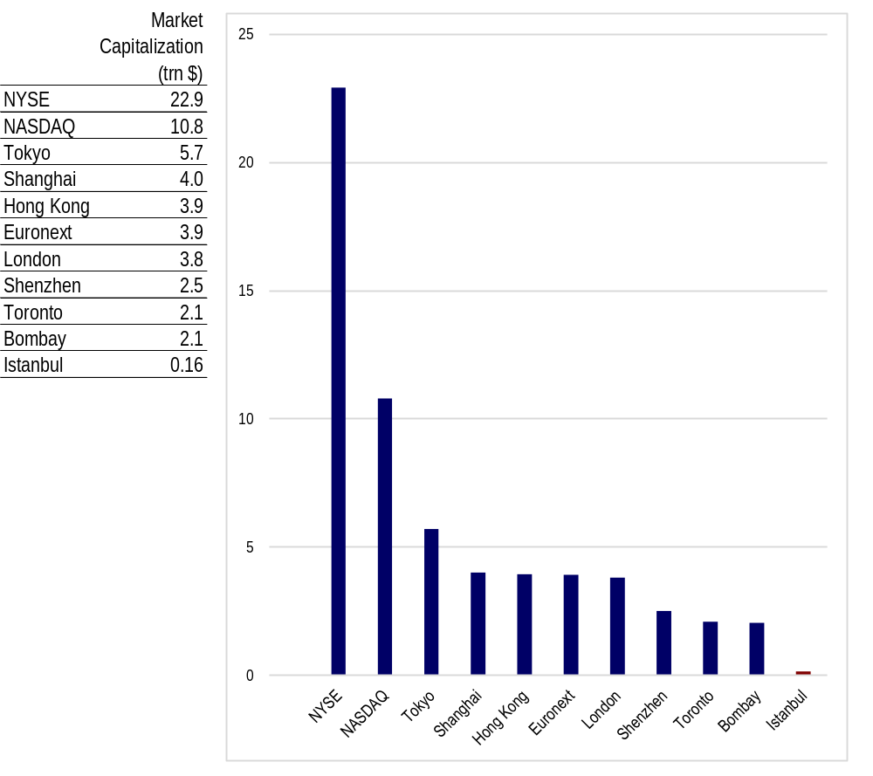
NTE 1010 – Introduction to Finance for Engineers
Stock Markets in the World

Slide 19
NTE 1010.1 – Introduction to Finance for Engineers
Borsa İstanbul
Debt Securities Market
  Debt securities, securitized asset and income backed debt securities, lease certificates,
  liquidity bills issued by the Central Bank of Turkey are traded.
  Trading is conducted electronically via the automated multiple price-continous auction system.
  Settlement operations are realized by İstanbul Settlement and Custody Bank Inc. (Takasbank).
  Sub-markets are:
    Outright Purchases and Sales Market of fixed income securities
    Repo – Reverse Repo Market of fixed income securities
    Interbank Repo – Reverse Repo Market of fixed income securities
    Repo Market for Specified Securities
    Equity Repo Market
    Negotiated Repo Deals Market
    Offering Market for Qualified Investors
    International Bonds Market of ″Eurobonds″ issued by the Turkish government

Slide 20
NTE 1010.1 – Introduction to Finance for Engineers
Borsa İstanbul
Equity Market
  Equities, preemptive rights, exchange traded funds, warrants and certificates are traded.
  Trading is carried out based on price and priority, with
  ″continous auction″, ″continous auction and market maker″ and ″single price″ trading methods
  with a fully automated electronic trading system.
  Sub-markets are:
  BIST STARS: market value of free float > 100 million TL or included in BIST 100 index
  BIST MAIN: 100 million TL > market value of free float > 25 million TL
  BIST EMERGING CO’s: 25 million TL > market value of free float
  WATCHLIST: Co’s subject to monitoring due to financial problems
  COLLECTIVE & STRUCTURED PRODUCTS: Exchange traded funds, warrants, certificates.
  QUALIFIED INVESTORS: Shares sold directly to qualified investors; no public offering.
  PRE-MARKET TRADING: Publicly held co’s (100+ shareholders) not listed in Borsa İstanbul.

Slide 21
NTE 1010.1 – Introduction to Finance for Engineers
Borsa İstanbul
Derivatives Market
      Trading volume in 2017 was 868 billion TL,
      12% of total BIST volume.
      Sub-markets:
      FX
      Electric
      Commodity
      Index
      Percious Metals
      Equity
      Foreign Indices
      Metal
      ETF
      Interest Rates

Slide 22
NTE 1010.1 – Introduction to Finance for Engineers
Borsa İstanbul
Precious Metals & Diamond Market
      Trading volume in 2017 was 68 billion TL, 1% of total BIST volume.
      Sub-markets:
      Precious Metals – includes the spot trade of standard and non-standard gold, silver, platinum, and palldium.
      Precious Metal Lending – provides lending and certificate transactions.
      Diamond and Precious Stone

Slide 23
NTE 1010.1 – Introduction to Finance for Engineers
Borsa İstanbul
Other Services
      In addition to Trading:
      Listing
      Settlement – Takasbank
      Custody – Central Registry Agency: securities depository
      Index and Data

Slide 24
NTE 1010 – Introduction to Finance for Engineers
Financial System
Indirect Finance / Financial Intermediaries
Indirect Finance involves
Financial Intermediaries that stand between the lender-savers and the borrower-spenders
and helps transfer funds from one to the other.
This is called financial intermediation.
Financial Intermediaries can substantially reduce transaction costs
because they have developed expertise in lowering them
and because their large size allows them to take advantage of Economies of Scale,
i.e. the reduction in transaction costs per dollar of transactions
as the size (scale) of transactions increase.
Financial Intermediaries may also provide liquidity services
such as banks providing depositors with checking accounts that enable them to pay their bills easily.
Financial Intermediaries help reduce the exposure of investors to risk.
They create and sell assets with risk characteristics that people are comfortable with,
and then use these funds to purchase other assets that may have far more risk.
This process is called risk sharing or asset transformation.

Slide 25
NTE 1010 – Introduction to Finance for Engineers
Financial System
Types of Financial Intermediaries
Banks accept deposits from individuals and institutions and make loans.
Life Insurance / Pension Companies insure people
against financial hazards following a death
and sell annuities (annual income payments upon retirement).
They acquire funds from the premiums that people pay to keep their policies in force
and use them to invest in financial markets.
Mutual Funds acquire funds by selling their own shares to many individuals
and use the proceeds to purchase diversified portfolios of stocks and bonds.

Slide 26
NTE 1010 – Introduction to Finance for Engineers
Financial System
Regulation of the System
Financial systems are among the most heavily regulated sectors in the world.
Governments regulate financial systems,
to increase the information available to investors, and
to ensure the soundness of the system.
Bankacılık Düzenleme ve Denetleme Kurulu (BDDK)
regulates and supervises
banks.
Before Hazine Müsteşarlığı (Undersecretariat of the Treasury)
used to regulate and supervise
insurance companies;
now, a separate supervisory board similar to BDDK has been established.
Sermaye Piyasası Kurulu (SPK)
regulates and supervises
capital markets.

Slide 27
NTE 1010 – Introduction to Finance for Engineers
Financial System
Regulation of the System
Governments regulate financial systems via the following:
Restrictions on Entry – Those who want to establish a financial intermediary must obtain a charter from the government.Only those with impeccable credentials and a large amount of initial funds will be given a charter.
Disclosure - Bookkeeping of financial intermediaries must follow certain strict principles, their books are subject to periodic inspection, and they must make certain information available to public.
Restrictions on Assets and Activities – Financial Intermediaries are restricted from holding certain risky assets and/or holding them in unreasonably high quantities.
Deposit Insurance – The government insures people’s deposits so that they do not suffer great financial loss if the financial intermediary that holds these deposits should fail.
In Turkey, deposits of individuals are insured up to TL 100,000 separately for each bank.
Limits on Competition – Opening a bank branch is subject to regulatory approval.
Restrictions on Interest Rates – Regulator may restrict interest paid on deposits and other financial instruments which may be unrealistic in economic terms for the sake of overall good.
    Also, Central Bank may guide banks by determining the interest of the funds that it provides to banks.

Slide 28
NTE 1010
Introduction to Finance for Engineers
week 5
Financial System & Money
Money

Slide 29
NTE 1010 – Introduction to Finance for Engineers
Economy
  The term ″economy″ originates from the Greek Word of ″oikonomia″
  which means ″household management″.
  Nowadays, ″economy″ very simply covers topics of
  ″producing″ and ″sharing″.
  ″First human″ is estimated to have appeared on earth 200,000 years ago.
  Agriculture and trading started 10,000 years ago in Mesopothamia;
  until then humans were ″gatherers″ and ″hunters″.
  With agriculture, they became ″producers″;
  surplus production made them ″traders″.
  ″Trading″ introduced ″sharing″.
  So appeared the ″economy″.

Slide 30
NTE 1010 – Introduction to Finance for Engineers
Money
  Trading of goods was cumbersome;
  it was not easy to find some who had what you needed
  and at the same time who needed what you had.
  ″Money″ as the common denominator of trade made things easier.
  First Money, in metal form, was used by the Lydians 2,700 years ago
  who had lived in and around Teke Yarımadası of today.
  Most precious metal money was in gold,
  secondarily in silver.
  As the production and trade increased in history,
  supply of precious metals became insufficient in supporting world trade.
  So, ″paper money″ appeared as a promise to give gold on demand.
  About 45 years ago, ″gold standard″ in paper money was abandoned.

Slide 31
NTE 1010 – Introduction to Finance for Engineers
Money
Primary Functions
  Money in the form of currency, checks or electronic cards is
  a Medium of Exchange;
  it is used to pay for goods and services.
  This promotes economic efficiency by minimizing the time spent in exchanging goods and services.
  Money provides a Unit of Account;
  it is used to measure value in the economy.
  We measure the value of goods and services in terms of money,
  just as we measure weight in terms of grams or distance in meters.
  Money also functions as a Store of Value;
  it is a repository of purchasing power over time.
  A store of value is used to save purchasing power from the time income is received until the time it is spent.

Slide 32
NTE 1010 – Introduction to Finance for Engineers
Money
Measurement
  There are expanding levels of money measurement:
  M0 = physical money
  (paper, coin, deposits of banks at Central Bank which the Central Bank has to provide cash on demand)
  M1 = M0 +current deposits
  M2 = M1 +deposits with maturity of less than 30 days
  M3 = M2 +time deposits

